Slide 1
COMP 2710 Software Construction
Overall Performance
Dr. Xiao Qin
Auburn University
http://www.eng.auburn.edu/~xqin
xqin@auburn.edu
Fall, 2011

Slide 2
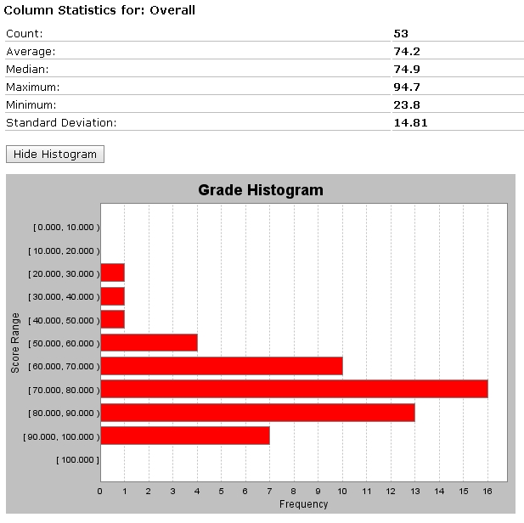
1-<number>

Slide 3
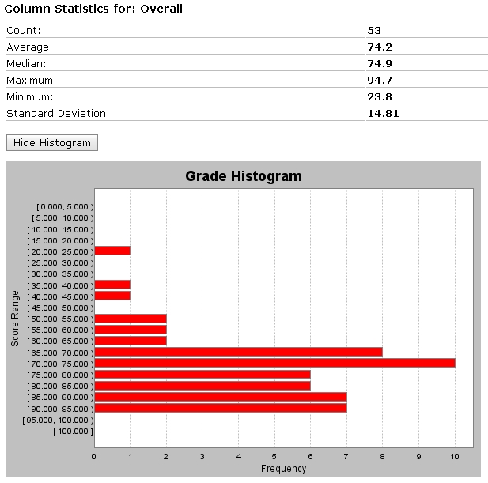
Letter Score #of Stud
A >84 15 29%
B >71 20 38%
C >64 9 17%
D >55 1 2%
F <55 7 13%
Failed in HW+Proj
7
Failed in Exams
3
1-<number>

